Slide 1
Distance-Based Suspicion Score for Audit Selection
presented by Nuriddin Tojiboyev

Slide 2
Audit Selection
Population of Records
Sample – representative of population
Records to Review
Selection – risk-based filtering
Notes:
Audit Research has long been discussing and proposing selection methods for review process. Although, initially random sampling methods were used widely in profession, lately, because of advancements in data processing capabilities, usage of filters and rules to select records for review is becoming more and more popular.

Slide 3
Records, Filters and Exceptions
10
8
6
4
2
0
Transaction Records
Examples of Risk for Filters
Unauthorized salary increases
Inflated overtime hours
Payments to Terminated employees
Duplicate Payments
Unauthorized travel/vacation payments
Filters/Rules
Exceptions

Slide 4
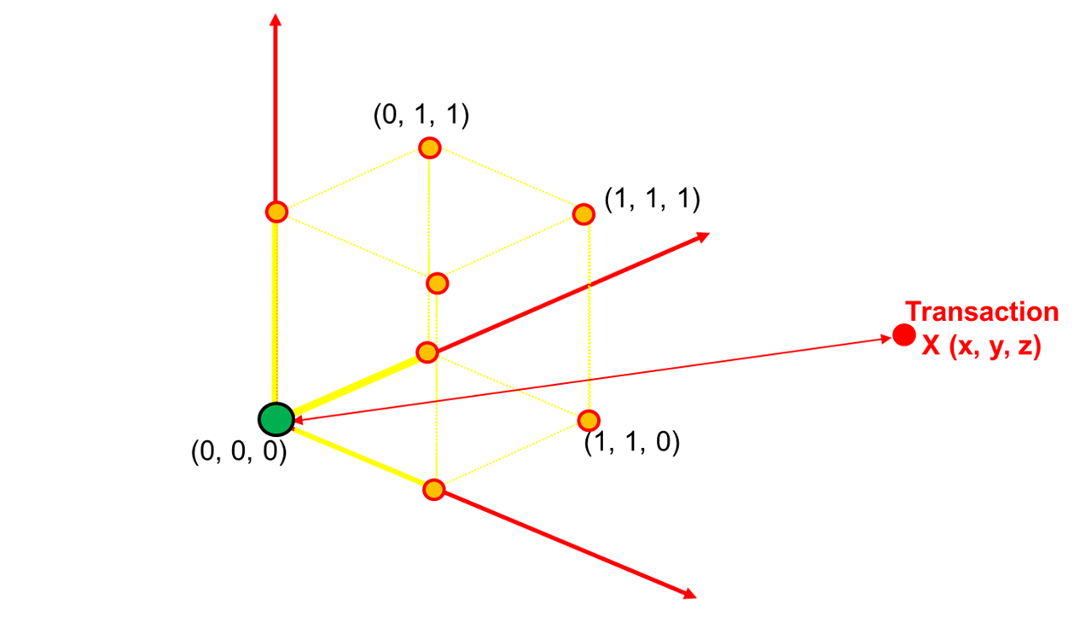
“Risk Space”
Notes:
Characteristics of “Risk Space”
“Risk Space” is made of “risk dimensions”
Each “risk dimension” represents a metric for how each transaction puts each relevant assertion at risk.
Prior literature methods allows data points only be at edges of the “unit cube”.
Comparability among “risk dimensions” allows to aggregate the riskiness of transactions on all “risk dimensions”
Investigator should be indifferent to investigate on of the transactions have same level of risk on two different “risk dimensions”
The main question is how to engineer “risk measures” for risk dimensions
One way is a “Thresholds Approach”

Slide 5
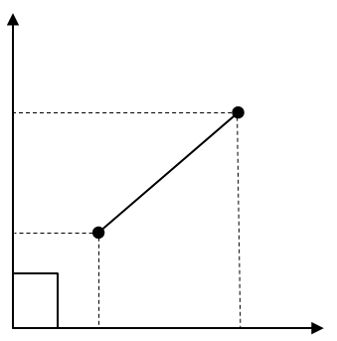
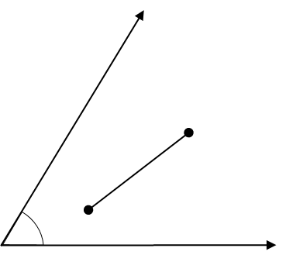
Euclidian
Distance Measures
Mahalanobis

Slide 6
Exception List Sorted by Suspicion Score

Slide 7
Similar Risk Composition

Slide 8
Visualization of Risk Composition
Overtime Filter
Salary Increase Filter
Notes:
Characteristics of “Risk Space”
“Risk Space” is made of “risk dimensions”
Each “risk dimension” represents a metric for how each transaction puts each relevant assertion at risk.
Prior literature methods allows data points only be at edges of the “unit cube”.
Comparability among “risk dimensions” allows to aggregate the riskiness of transactions on all “risk dimensions”
Investigator should be indifferent to investigate on of the transactions have same level of risk on two different “risk dimensions”
The main question is how to engineer “risk measures” for risk dimensions
One way is a “Thresholds Approach”

Slide 9
Skipper and Stretcher

Slide 10
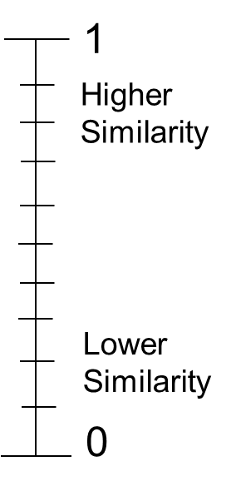
Visualization of Skipper Approach
Overtime Filter
Salary Increase Filter
Notes:
Characteristics of “Risk Space”
“Risk Space” is made of “risk dimensions”
Each “risk dimension” represents a metric for how each transaction puts each relevant assertion at risk.
Prior literature methods allows data points only be at edges of the “unit cube”.
Comparability among “risk dimensions” allows to aggregate the riskiness of transactions on all “risk dimensions”
Investigator should be indifferent to investigate on of the transactions have same level of risk on two different “risk dimensions”
The main question is how to engineer “risk measures” for risk dimensions
One way is a “Thresholds Approach”

Slide 11
Skipper Selection Strategy
Set a maximum similarity threshold for the selection set
Select one exception at a time, running down the exception list sorted by suspicion score
Select the exception to the selection if no similar exception already exists in the selection set
Notes:
Skipper refers to an algorithm logic according to which an exception candidate in the list of exceptions sorted by suspicion score is skipped if a similar exception already exists in the selection set. User defines the similarity parameter and sets the Maximum Similarity Threshold.

Slide 12
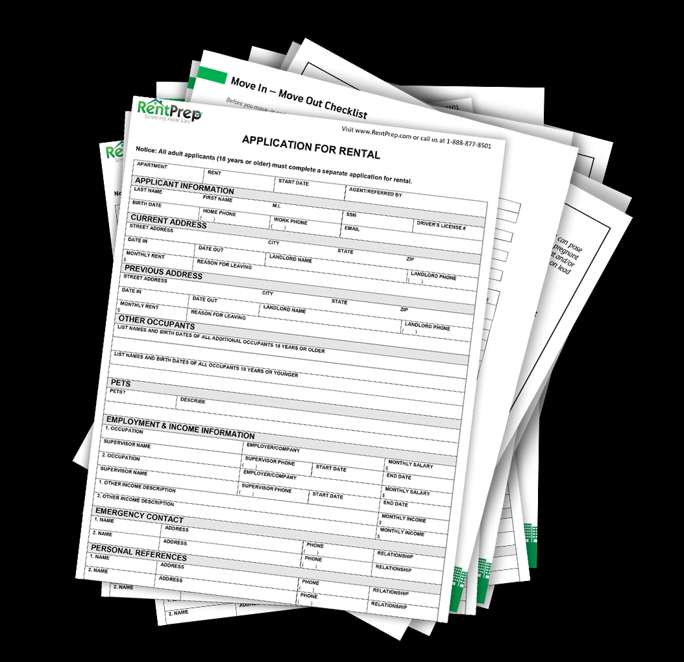
Exception Selection Procedure
For each candidate, calculate similarity to each of the already selected items
Include the candidate to the selection if maximum of similarity scores of the candidate to the already selected items is less or equal to threshold
Terminate when sample size is reached, or exception list is fully covered
Population Sorted By Risk Score
Selection
…skip
…skip
…skip
…skip
…skip
…skip
…skip
…skip

Slide 13
Importance of selecting correct threshold for similarity
1
Higher
Similarity
If similarity threshold is too high, selection budget is exhausted too early and not all of the exceptions will be considered as a candidate
If similarity threshold is too low, the procedure will skip most exceptions and may not achieve the intended selection size
Lower
Similarity
0
Notes:
Extreme Values:
If Max_Sim = 1 and Size = 100, first 100 exceptions are selected and the rest of the exceptions in the list is ignored, because sample size is reached
If Max_Sim = 0 and Size = 100, first item is selected and data points at 90 degrees to the first items and with highest suspicion scores are also selected. But all of the rest are skipped resulting in maximum of items less than number of dimensions (filters)

Slide 14
Visualization of Stretcher Approach
Overtime Filter
Low Risk
Salary Increase Filter
Notes:
Characteristics of “Risk Space”
“Risk Space” is made of “risk dimensions”
Each “risk dimension” represents a metric for how each transaction puts each relevant assertion at risk.
Prior literature methods allows data points only be at edges of the “unit cube”.
Comparability among “risk dimensions” allows to aggregate the riskiness of transactions on all “risk dimensions”
Investigator should be indifferent to investigate on of the transactions have same level of risk on two different “risk dimensions”
The main question is how to engineer “risk measures” for risk dimensions
One way is a “Thresholds Approach”

Slide 15
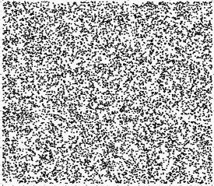
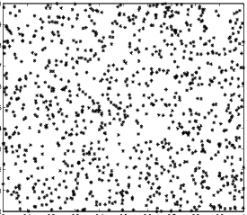
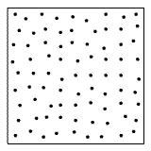
Stretcher Selection Strategy
Identify the set of the exceptions from population that are over certain minimum risk score
From the selected set of the riskiest exceptions, select the combination of items that are the most dissimilar to each other for a given set size.
N= 50,000
N= 1,000
N= 100
Notes:
Stretcher refers to an algorithm logic that selects the subset of the most unsimiliar items to each other from the candidate list regardless of their suspicion scores. User defines the similarity parameter. The ideal solution is computationally intensive – prohibitively expensive. Thus, requires more heuristic approach.

Slide 16
Exception Selection Procedure for Stretcher
For all candidates, calculate the similarity matrix
Select the most two dissimilar candidates, then select one item a time depending candidate’s overall similarity to the already selected items (MaxMin Approach)
Terminate when sample size is reached
Population above certain Risk Score Threshold
Selection
Notes:
MaxMin – candidate with a lowest similarity to the most similar item (A longest distance to its closest neighbor)

Slide 17
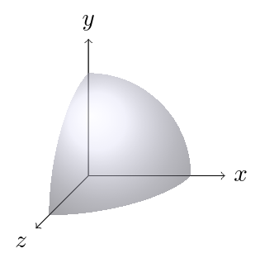
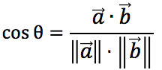
Similarity Measures
Angles
Distances
α

Slide 18
Few More Points…
Data Point Values vs Filter Values for Similarity
Similarity Measure Choice and Threshold Decision
Filter Effectiveness and Adequacy
Artifact Evaluation and Validation

Slide 19
Thank you!!! Questions?!

